Slide 1

MSBA PYTHON BOOTCAMP
Introduction
Notes:
Guidelines
Use section headers to chunk content in your presentation.
Use the same style of section header throughout your presentation.
Keep your title to no more than 2 lines.

Slide 2


Programming Languages
Business Analytics
Notes:
Guidelines
Use a title slide at the beginning of your presentation. There are 9 variations of title slides to choose from.
If you will have a series of slideshows, we recommend using the same style of title slide for each presentation.
Keep your title to no more than 2 lines.
Do not change the font style or font size of the title or subtitle.

Slide 3
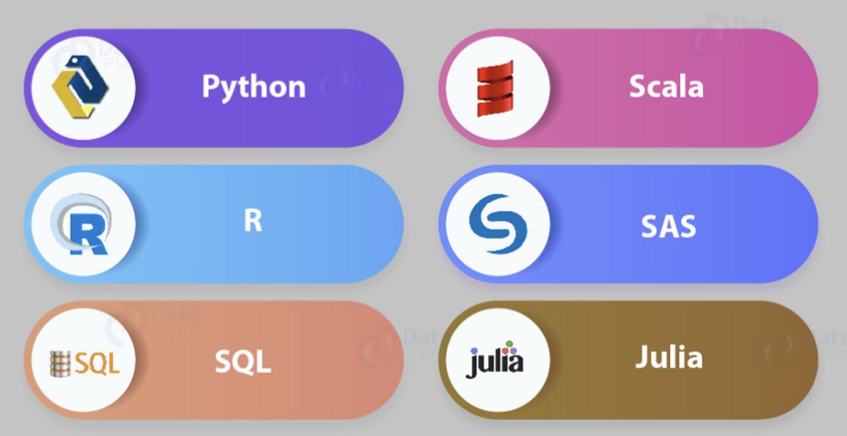
Options

Slide 4
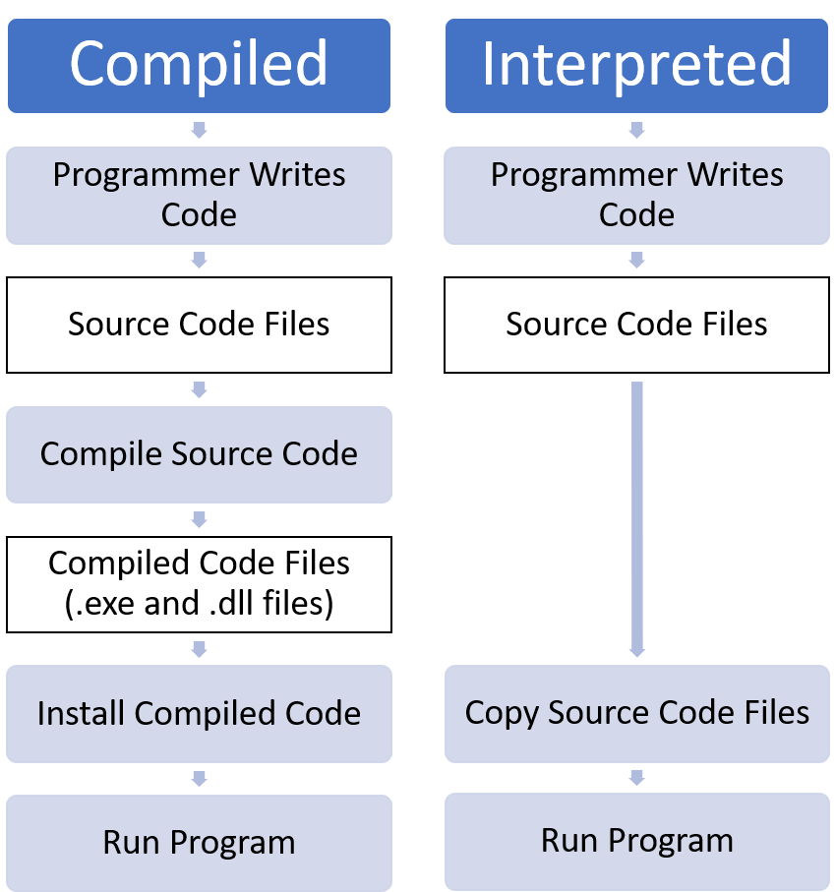
Types of Programming Languages

Slide 5




Interpreted Languages
Highly Flexible
Same across platforms, operating systems
Dynamically typed
Mostly free and open source
Vast libraries/modules support
Easier to debug (find errors in code)
Most often slower

Slide 6




Compiled Languages
Not cross platform
Inflexible
Takes an extra step (compiling)
Good luck finding errors!
Most often slower

Slide 7
Why Python and R?
Notes:
Guidelines
Use a title slide at the beginning of your presentation. There are 9 variations of title slides to choose from.
If you will have a series of slideshows, we recommend using the same style of title slide for each presentation.
Keep your title to no more than 2 lines.
Do not change the font style or font size of the title or subtitle.

Slide 8
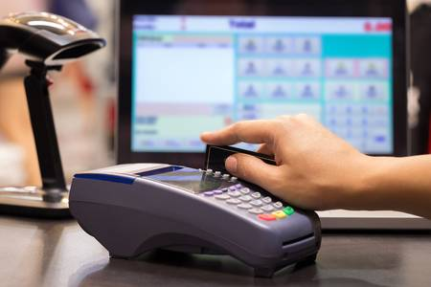
Example, What is Machine Learning
is the field of study that gives computers the ability to learn without being explicitly programmed (Arthur Samuel, 1959). Giving computers the ability to learn from data
Example: Credit Card Fraud Detection

Slide 9
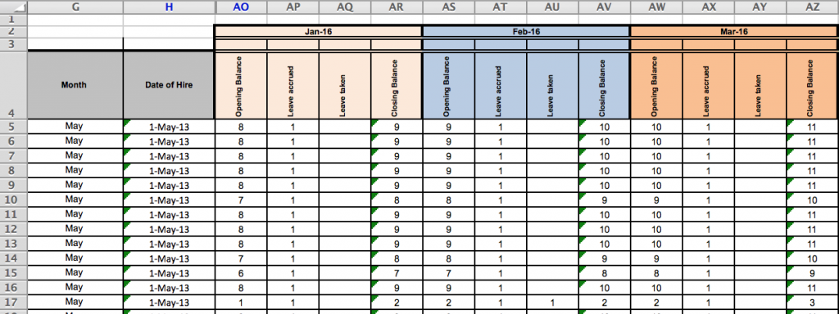
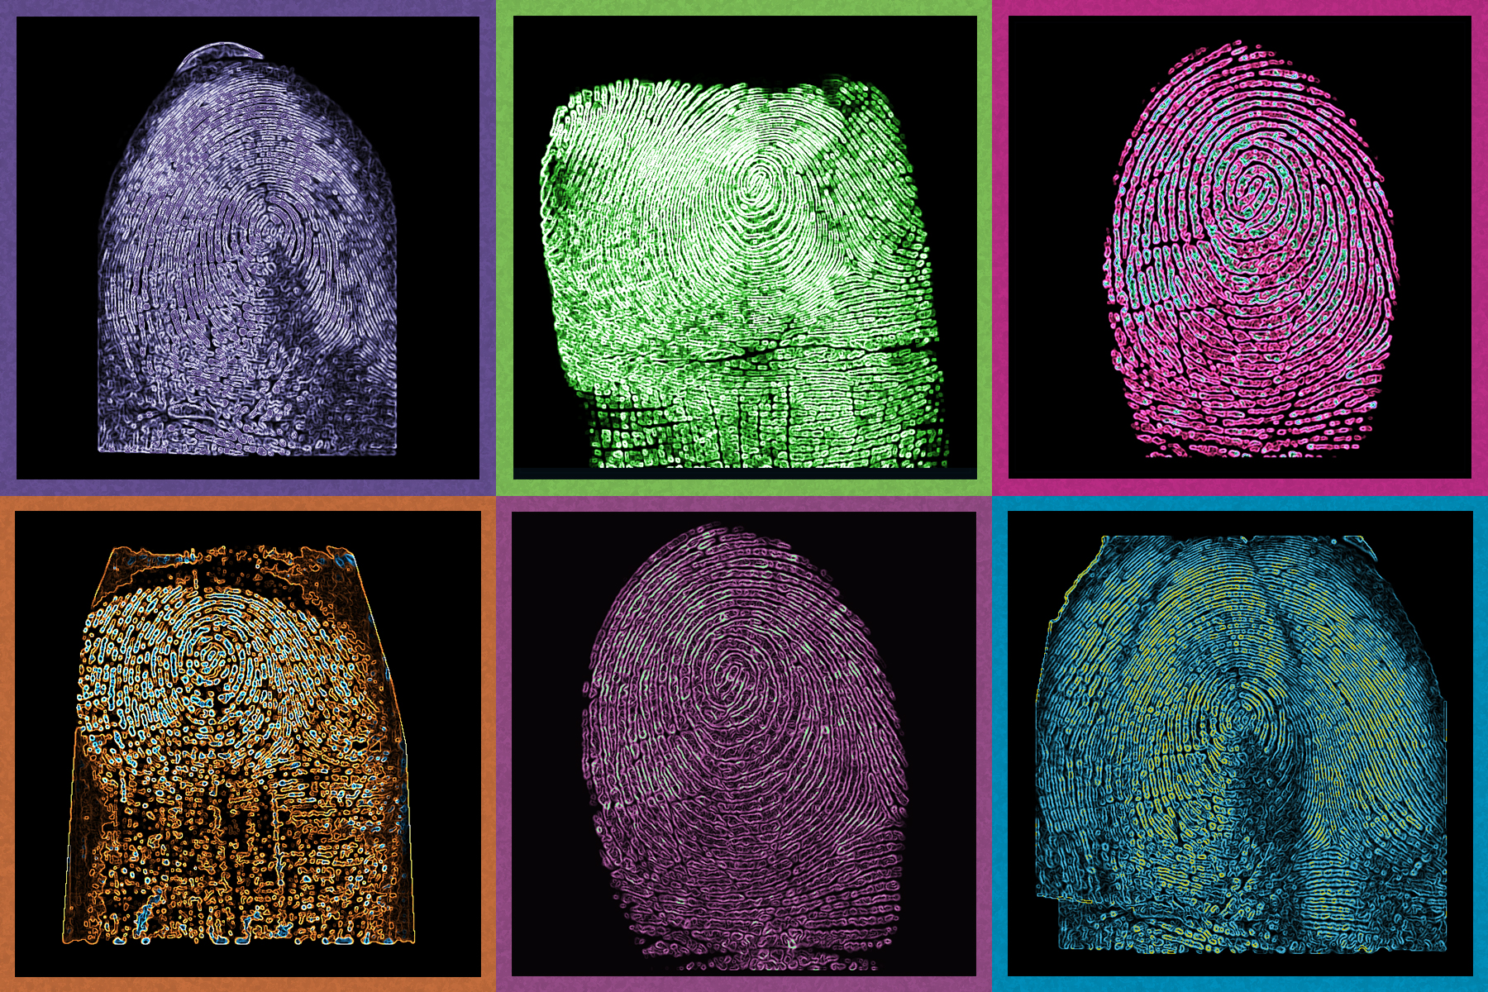
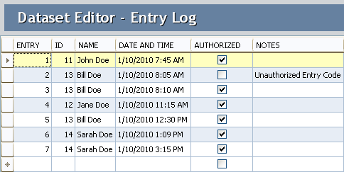
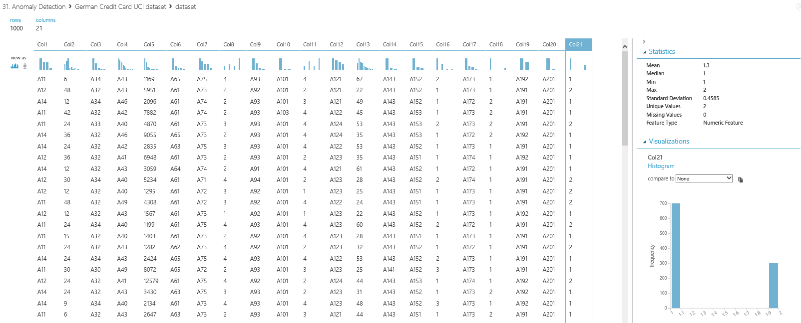
Example, What is Machine Learning
is the field of study that gives computers the ability to learn without being explicitly programmed (Arthur Samuel, 1959). Giving computers the ability to learn from data
Example: Fraud Detection

Slide 10
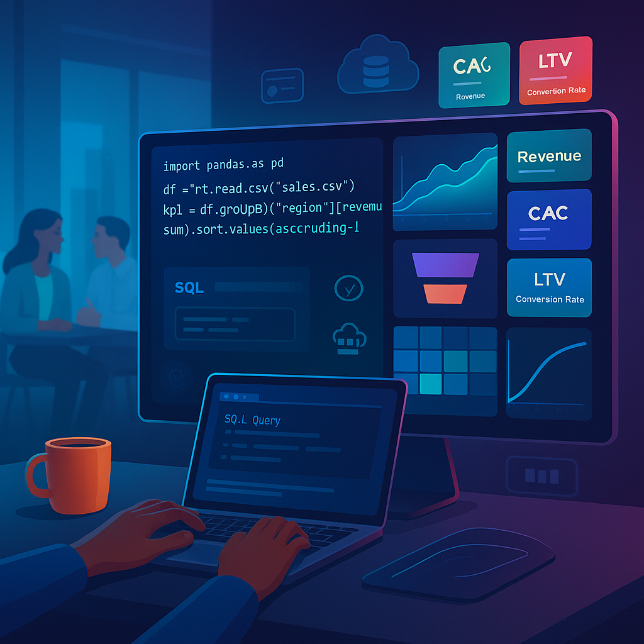
Why do we need coding?
Enables automation, deeper insights, and scalable solutions

Slide 11
Programming Environments
Notes:
Guidelines
Use a title slide at the beginning of your presentation. There are 9 variations of title slides to choose from.
If you will have a series of slideshows, we recommend using the same style of title slide for each presentation.
Keep your title to no more than 2 lines.
Do not change the font style or font size of the title or subtitle.

Slide 12
Anaconda
Distribution of Python that includes most of the libraries and modules.
NumPy
Pandas
Matplotlib
Sklearn
Link: https://www.anaconda.com/download

Slide 13
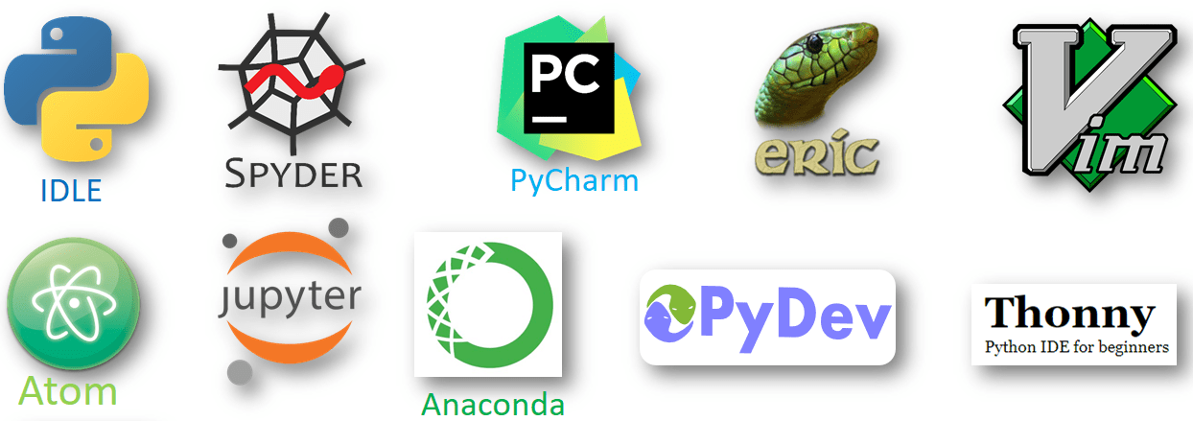
How do I code in Python?
There are many ways to code in Python

Slide 14
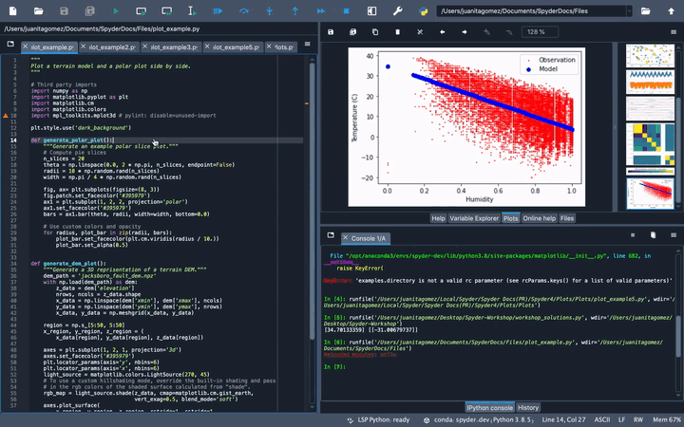
Integrated Development Environments
IDEs provide useful tools for faster programming. E.g. Spyder

Slide 15
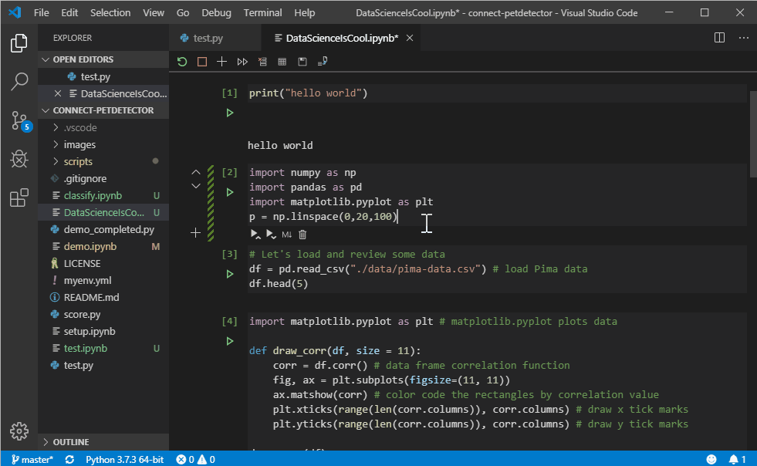
Integrated Development Environments
IDEs provide useful tools for faster programming. E.g. VS Code

Slide 16
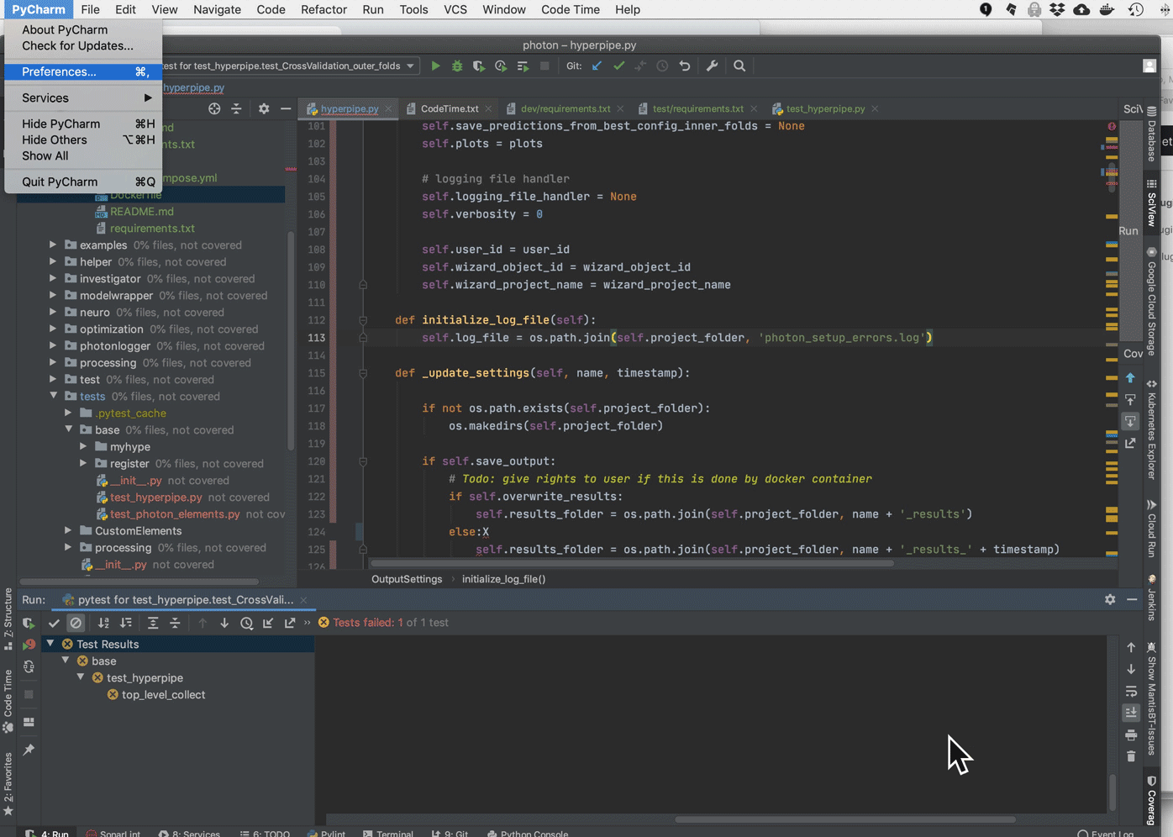
Integrated Development Environments
IDEs provide useful tools for faster programming. E.g. Pycharm

Slide 17
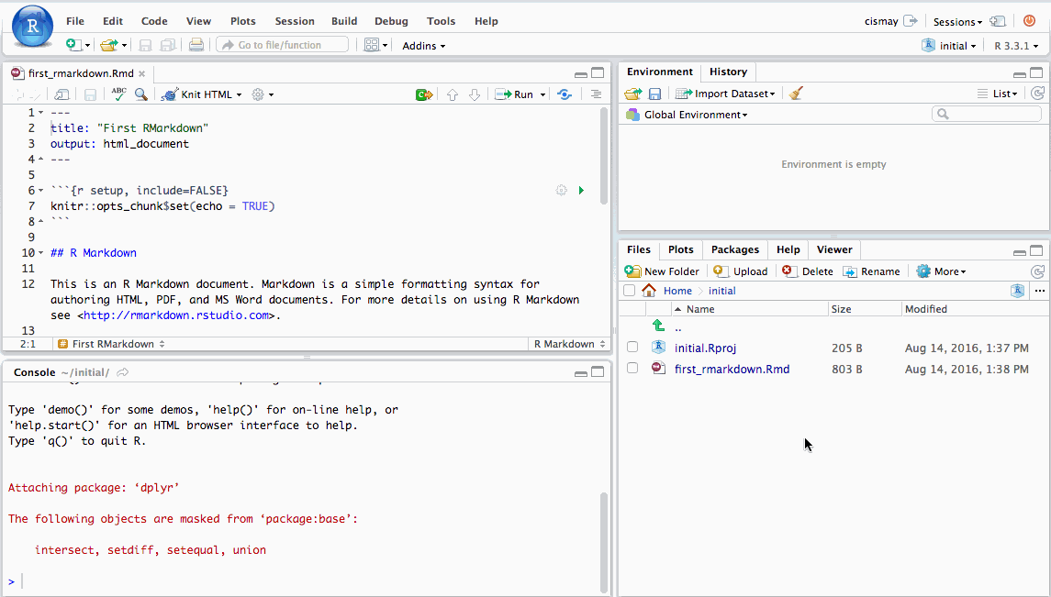
Integrated Development Environments
IDEs provide useful tools for faster programming. E.g. RStudio

Slide 18
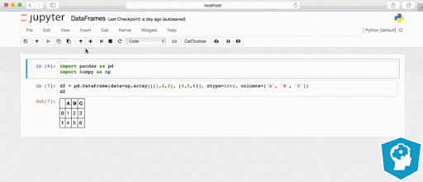
Jupyter Notebooks
Allows for code and text (markdown) cells

Slide 19

Practice
Notes:
Use this slide for graphics, tables, or images that are white in color.

Slide 20

Google Colab
Creating Colab Notebooks
Notes:
Guidelines
Use a title slide at the beginning of your presentation. There are 9 variations of title slides to choose from.
If you will have a series of slideshows, we recommend using the same style of title slide for each presentation.
Keep your title to no more than 2 lines.
Do not change the font style or font size of the title or subtitle.

Slide 21
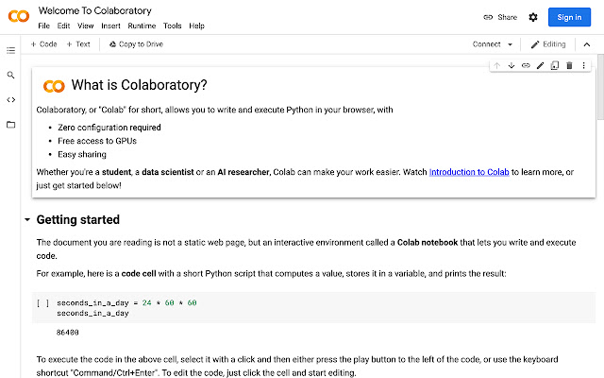
Google Collaboratory (Colab)
Allows you to run Python notebooks on remote computer
Complete installations of Python and ML modules
Allows users to use GPUs and TPUs for faster computations

